Slide 1

Pointers for Success at Acadia and Beyond
Following these guidelines will help you not only at Acadia, but also in your future.
Professor Connie Foote and Professor Yinglei Wang
with thanks to Dr. Wanda Campbell, Dr. Rob Raeside and many others

Slide 2
Pointers for Success in the Classroom
Behaviour in the Classroom
Interacting with your Professors
Group work
Critical Thinking

Slide 3

Behaviour in the Classroom
Attendance is important
  Grades can be affected directly and indirectly by attendance
Punctuality
Arrive on time, if late be discrete
Cell phones
Turn off so as not to distract
Notes:
Attendance is important
Grades are sometimes based on attendance (e.g., participation)
It is better to get information first-hand (don’t rely on peers; they may not always be reliable)
Arrive on time for class
If you are late, enter discretely
Cell phone
Turn it off before class
If it rings, turn it off OR take the call elsewhere

Slide 4
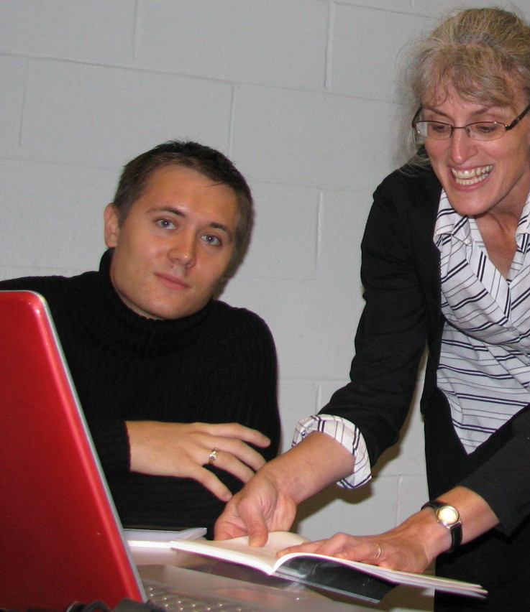
Behaviour in the Classroom
Laptop use
not mandatory in every class
your professor will inform you
about how and when to use it.
Appropriate use:
Taking notes, in-class work, etc.
Inappropriate use:
Any material unrelated to the course
including E-mail, movies, surfing the web, facebook, etc.
  Show respect for the professor and other classmates.
Notes:
Laptop use in class
Not mandatory to use in every class
e.g., notes can be taken by hand
Have the laptop on before class
Turn off the sound on your computer
Be respectful of others in the classroom
Use the laptop for taking notes, doing in-class work and assignments, etc.
Do not use the laptop for material that is unrelated to the course
E-mail, movies, surfing the web, MSN, etc.
If another student is doing it, you can move to another spot or tell the student to stop.

Slide 5
Behaviour in the Classroom
What if you are sick or have a family emergency?
  Contact the professor and get documentation to the Registrar
  Missing class, get notes and see professor if you have questions.
  Assignments and tests, check on the professor’s policies
Notes:
What if you are sick or have a family emergency?
Documentation and contacting the professor
It is important that you contact the professor and provide documentation (e.g., doctor’s note; obituary or death certificate) to the Registrar’s Office as soon as possible
Missing class
Get the notes from a peer. After you have reviewed them, come to office hours if you have questions.
Assignments and tests
Professors have different policies regarding assignments & tests (e.g., you may be allowed to write a make-up test; others may transfer the weight of the missed test to the final exam).

Slide 6
Behaviour in the Classroom
If you do not have a documented reason for missing class, do not expect the same type of accommodations
  Class
  Assignments
  Tests
Notes:
If you do not have a documented reason for missing class, do not expect the same type of accommodations
Class
You are welcome to ask specific questions about the material you missed, but professors will not go over the entire class with you.
Assignments
Late assignments are often penalized (e.g., 10% per day). Some professors may not accept late assignments.
Tests
A grade of zero is normally assigned for tests missed without a valid reason.

Slide 7
Interacting with your Professors
Office Hours
  Make use of office hours
  We are there for you.
  Come as soon as possible.
  Don’t wait if you are having difficulties.
  Be prepared with questions and concerns.
Notes:
Office hours
Make use of office hours
Do not be afraid to go and see a professor
These are the times that professors have set aside to meet with students
Come as soon as possible
It is better to ask questions about difficult material before a midterm
Be prepared
Have a list of questions ready
Have your computer ready

Slide 8
Interacting with your Professors
How to address your professors?
  Take your cue from the professor
  When in doubt, be formal
  Use your Acadia e-mail address when communicating with faculty members
  Check your Acadia e-mail regularly
Notes:
How to address your professors?
Take your cue from the professor
When in doubt, be formal (regardless of the professor’s background, i.e., whether the professor is male or female, young or old)

Slide 9
What is wrong with this e-mail message?
Saturday, 3:00 a.m.
hey! i cudnt make it ta class yesturday because i wuz out late with my budies lost nite lol. i would of been there but i slept in and woke up with like this a magor wiked hungover dude:( did i miss anything important. send me notes of what missed. oh & whats on mundays test
-- 2 minutes later --
hey! whazzup man why hevent you guten back to me

Slide 10
Group Work &
Class Participation
Class Participation
  Feel free (raise your hand) to ask and answer questions, to express your viewpoint.
  Student-led discussions and presentations in class are common.
  Always be respectful of classmates and professors.
Notes:
Sometimes there are student-led discussion and presentations in class
Foster critical thinking,
Discussion helps understand the opposing views
More interesting than lecture format
Encourages better preparation
Develop public speaking skills
Do not be afraid to answer questions or contribute to classroom discussion
Feel free to ask questions in class (raise your hand).
It is ok to make mistakes – that is how we all learn!

Slide 11
Group Work &
Class Participation
Class Participation – why?
  - foster critical thinking
  - understand opposing views
  - variety of formats
  - encourages preparation
  - develops public speaking skills.
Notes:
Sometimes there are student-led discussion and presentations in class
Foster critical thinking,
Discussion helps understand the opposing views
More interesting than lecture format
Encourages better preparation
Develop public speaking skills
Do not be afraid to answer questions or contribute to classroom discussion
Feel free to ask questions in class (raise your hand).
It is ok to make mistakes – that is how we all learn!

Slide 12
Group Work & Class Participation
Equality
  All students are considered equal.
  If students are asked to participate, all should feel free to do so.
  Classrooms and group meetings should be a safe place to speak and state your views and even make mistakes.
Notes:
All students at Acadia are considered equal, regardless of gender, age, race, religion, caste, social class, etc.
Professors want to hear from all of you.
It is ok to make mistakes – that is how we all learn!

Slide 13
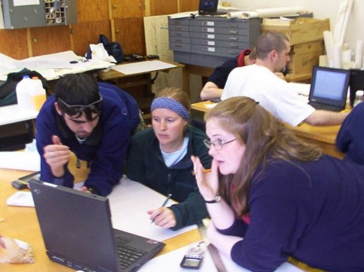
Group Work & Class Participation
Group work
  Usually assigned by instructor.
  Offer to do what you are good at – but seek variety.
  Don’t be shy.
Notes:
Choose group members wisely
Do not just choose people because they are friends, from your residence, etc.
Make sure that you have similar working habits and that they will contribute

Slide 14
Group Work & Class Participation
Group work
  Don’t be afraid to contribute your ideas.
  May be graded individually.
Notes:
Choose group members wisely
Do not just choose people because they are friends, from your residence, etc.
Make sure that you have similar working habits and that they will contribute

Slide 15
critical thinking
Education versus training
  Training: narrow focus leading to high skills proficiency
  Education: broad perspective leading to ability to solve problems
  Different ways of thinking.

Slide 16
critical thinking
“Thinking about thinking”
  Conceptualization, analysis,
  application, evaluation.
  Requires gathering all the facts and then reflecting on them
  ---------------------
  Not applicable in every course.
Notes:
“reasonable reflective thinking focused on deciding what to believe or do.”
"the intellectually disciplined process of actively and skillfully conceptualizing, applying, analyzing, synthesizing, and/or evaluating information gathered from, or generated by, observation, experience, reflection, reasoning, or communication, as a guide to belief and action"

Slide 17
Academic Integrity
Cheating
Plagiarism
How can you avoid plagiarizing?
When & how do you cite a source?

Slide 18
Academic Integrity
Cheating and plagiarism are not tolerated in university.
  Read pp.33-34 of the 2012/13 Acadia University academic calendar.
  Penalties vary from re-doing the work,
  a letter in your file, failing the assignment, failing the course, expulsion from the university.
Cheaters cheat themselves
Notes:
Possible penalties
Re-do the assigned work
letter in your file in the Registrar’s office
Fail the assignment, paper or test
Fail the course
Expulsion from the university
Cheaters are the biggest losers
Students come to university to learn
Learning is avoided when cheating is used
Classmates and profs often know if you cheat,
Do you want to graduate with that?

Slide 19

What is cheating?
Passing in someone else’s words or ideas as your own in reports and tests
  Copying, buying term papers, plagiarizing.
  Using the same paper in two or more courses.
  Helping someone else cheat.
Notes:
If you help someone cheat or plagiarize you may be considered equally guilty of the infraction
E.g., Giving someone your paper or assignment to copy

Slide 20
What is Plagiarism?
Plagiarism is stealing another person’s words or ideas and presenting them as if they
were your own
  Failing to cite sources of information used,
  Improper use of quotes.
Notes:
Using the same paper in two or more courses .

Slide 21
Academic Integrity
How can you avoid plagiarizing?
  Read enough articles to educate yourself
  Summarize in your notes,
  Write your own words,
  Cite any idea that was not your own
  Never copy/paste text.
Notes:
How can you avoid plagiarizing?
Read enough articles to educate yourself on the topic,
Summarize the main points in your notes,
Write what was written in your own words,
Cite any idea that was not your own
Do not copy/paste text in directly and then change a word or two.
If you use a direct quote, make sure that you use quotation marks and have all appropriate source information included.
Do not use too many quotes
Make sure you have a reference page, bibliography or works cited page
Never copy/paste text in directly and then change a word or two.

Slide 22
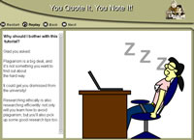
Academic Integrity
When & how do you cite a source?
  You do not need to cite a source if it is
  general knowledge.
  When in doubt, cite the source.
  Check out the plagiarism tutorial on the Library website:
Including the findings of other researchers in your term paper makes your paper better …
just give credit where credit is due.

Slide 23

Academic Integrity
If you are having difficulty with your assignment or paper, seek help from:
  Professor
  Academic librarian
  Writing centre
  Numeracy centre.

Slide 24
Pointers for Success Outside of the Classroom
Time Management
Study Strategies
Preparation
Making use of Campus Resources

Slide 25
Time management
How much time?
Use the course outline (syllabus) as a time management tool
Look closely at point values and allocate your time accordingly.
Notes:
How much time?
10 hours/week for each class (outside of class time)
Use the course outline (syllabus) as a time management tool
Add important dates to your schedule right away
Look closely at point values and allocate your time accordingly

Slide 26
Example
Time management
Testing and Grading Schedule
  Class Participation – 10%
  Lab reports (5) – 10%
  Term Assignment – 30%
  Midterm – 20%
  Final Exam – 30%
It’s Monday. You have a lab report due on Wednesday and the term assignment due on Friday. What should you do?

Slide 27
Make the most of your Time
Relax and rest
Rest before you get tired out (physically or mentally).
Take short breaks.
Be active in learning
Take notes.
Don’t just read over your notes.
Notes:
Make sure you are well-rested
Studying or working on a project when sleep-deprived is not productive
It is easy to make mistakes if you are sleep-deprived while studying, presenting , or writing an exam
Take occasional breaks while studying
Productivity decreases if you work at something continuously for hours at a time without a break, regardless of whether the activity is physical or mental.
For this reason, it is important to take rest breaks. The idea is to rest before you get tired. If you wait until you become tired, it’s too late. (analogy: replenishing fluids & electrolytes while exercising on a hot day)

Slide 28
other study strategies
Set specific goals
Ensure your goals can be achieved!
Work in groups?
Employ critical thinking.
Be active in learning
Mark up your notes, textbook.
Imagine possible test questions.
Notes:
Other tips for active studying:
Can work in groups instead of studying by yourself. However, be careful to ensure that everyone is working and not socializing.
Ask yourself how one concept differs from another
Think about applications of the material

Slide 29
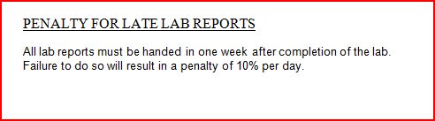
Class preparation
Before class:
Know and understand previous class.
Read pre-assigned material.
Do assigned tasks (“homework”).
Sleep and eat.
Notes:
Some readings and assigned tasks should be done BEFORE class.

Slide 30
After class
Later that day:
Make sure you understand the class.
Read assigned material.
Do assigned tasks (“homework”).
Pick out possible test questions.
List items you don’t understand.
Notes:
Other readings and assigned tasks will be assigned in class.

Slide 31
campus resources
Many resources available to you:
professor’s office hours
your home department’s resources
Writing Centre, MA∫H
Vaughan Memorial Library
Interactive Tutorials
Student Services
http://www2.acadiau.ca/student-services.html

Slide 32

Campus Resources
Ask for help if you need it.
Use resources at the
Wong International Centre,
at the corner of Highland and Acadia http://wic.acadiau.ca/

Slide 33

Questions?
Student Resource Centre http://counsel.acadiau.ca/
Acadia Students' Union Centre,
Old SUB Complex, Lower Level
Socialize with a variety of people.
Take time to exercise & eat healthy food.
Most of all: Do your best and enjoy
the Acadia experience!

